Slide 1


SAROPS:
Search And Rescue
Optimal Planning System
Art Allen
U.S. Coast Guard
Office of Search and Rescue
Arthur.A.Allen@uscg.mil
860-441-2747
.
Notes:
Each slide has Notes here to help guide you through.

Slide 2
The SAROPS team
USCG: Robert Netsch, Jack Frost, Art Allen
NGMS: Jim Hanks, Bob Wilson
Metron, Inc. Larry Stone, Tom Kratzke
ASA: Eoin Howlett, Guy deWardener
and others
.
Notes:
Plus lot’s more from USCG, Northrop Grumman Management Group, Metron, and Applied Sciences Associates.

Slide 3
USCG SAROPS team
Art Allen: Leeway and LRC equations development
  Bias: More choices / more features
Jack Frost: Search Theory and Resource Allocation / original SAR and IT systems
  Bias: Internal defaults / end-to-end system
Robert Netsch: ArcGIS and previous GIS / SAR systems
  Bias: COTR, tracking the $ and tasks, keeping the features from previous systems that the controllers like.
.
Notes:
Plus lot’s more from USCG, Northrop Grumman Management Group, Metron, and Applied Sciences Associates.

Slide 4
SAROPS timeline
10/2003 - SAROPS Kick-Off
04/2005 – 9/2005 Rapid Prototyping
9/2005 - Major Review
10/2005 – 2/2006 major GUI reworked
2/06 – 9/2006 Rapid Prototyping
8/06 - EDS installed at OSC, Martinsburg WV
9/06 - SAROPS 1.0 delivered
10-12/06 Servers installed
1-2/07 Training of USCG 50 OPCENS
1/07 – 10/07 SAROPS 1.0 to 1.0.2.3 versions OPERATIONAL
.
Notes:
Rapid prototyping and close team work. USCG goes operational with SAROPS beginning of the year.

Slide 5
(CMF)
CJMTK Mapping Framework
(ArcGIS 10.2)
COP
EXT
WWW
TMS
GEBASE
EDS
Maptech
MORE
EXT’S
3D Analyst
SAROPS Extension
GUI
SIM
SAR Tools Extension
Flares, Patterns, Etc
Spatial - A
GeoStat - A
WeatherFlow
SAROPS
C-Map
Other…
Notes:
Block diagram of SAROPS to ArcGIS and other software.
SAROPS is an “extension” of ArcGIS

Slide 6
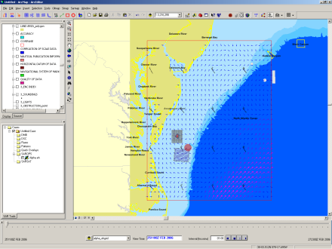
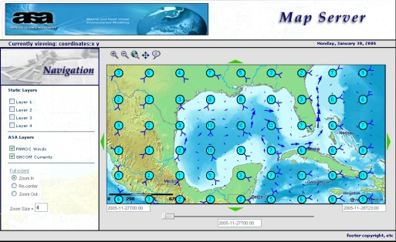

EDS Architecture
SIM uses Files
SAROPS Front End
Create Files
SAROPS Client
Web Service XML Request
NetCDF Data
Data Service
Spatial Aggregation Service
Temporal Aggregation Service
Objective Analysis
Web Services
Winds
Currents
Drifters
Weather
Environmental Database
Catalog Server
Catalog
Notes:
Block diagram of the Environmental Data Server (EDS)
The US Coast Guard Operational System Center (OSC) in Martinsburg, WV houses the EDS
SAROPS will be on terminal servers around the USCG and accessed from the USCG Standard Workstations (SWIII).
The EDS gets wind and current products from a number sources in their native format and the converts them to a single format (NetCDF) and archives them for SAROPS.
The Catalog Servers goes out to the EDS sources daily, 4x day, hourly and pulls the data into the database.
The EDS responses to request from SAROPS and returns data cubes to the user.

Slide 7
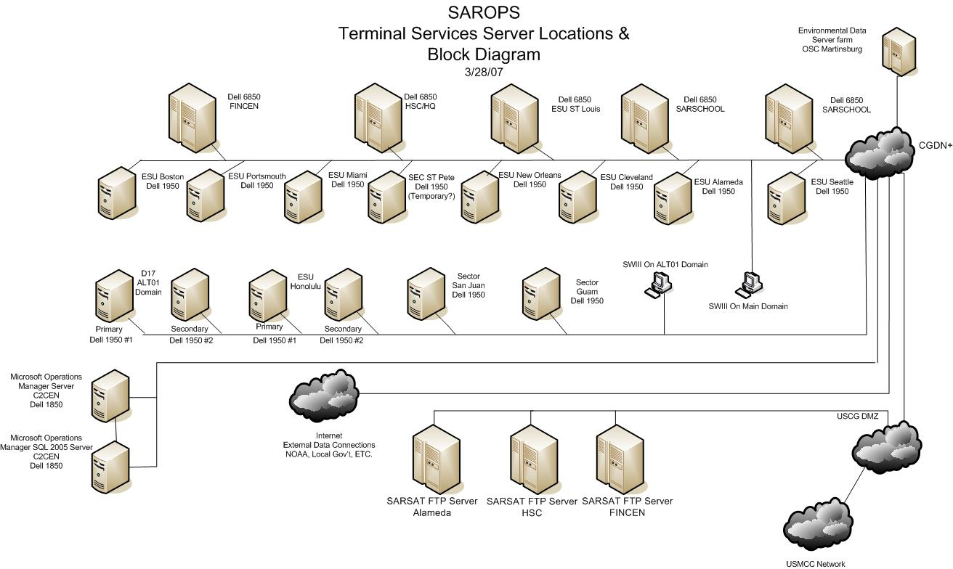
SAROPS Hardware

Slide 8
The SAROPS 1.0
Significant features
Combined Leeway and POD targets lists
Separated SAROPS from EDS
  Flexible / multiple Env. data sources
POD based on Lateral Range Curves
Optimal Search area(s) suggested
Account for relative motion of SRU vs. drift object
.

Slide 9
SAROPS
One Case, one run off US East Coast
Two scenarios
Two search objects
Two Search Rescue Units
.
Notes:
ArcGIS 9.1 or higher is commercially available
SAROPS is USCG owned.
EDS is USCG owned, but can be customized by ASA and run and maintained by ASA for your area.
SAROPS GUI’s (language, units) can be customized by ASA

Slide 10
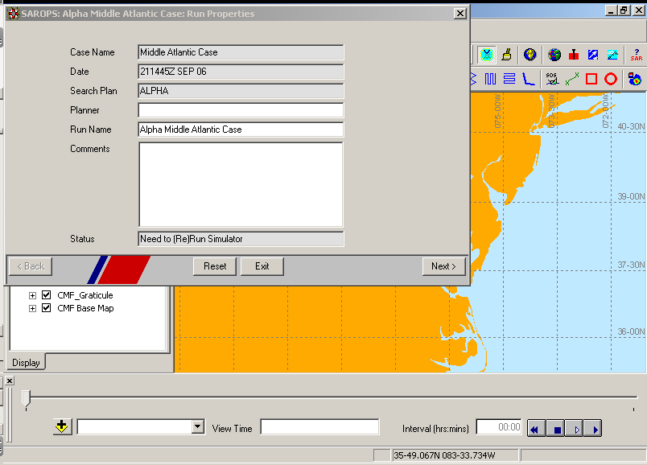

Slide 11
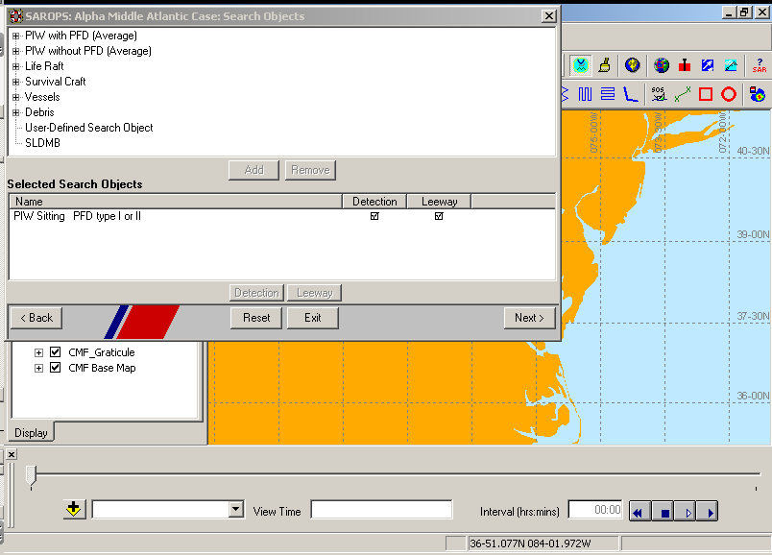
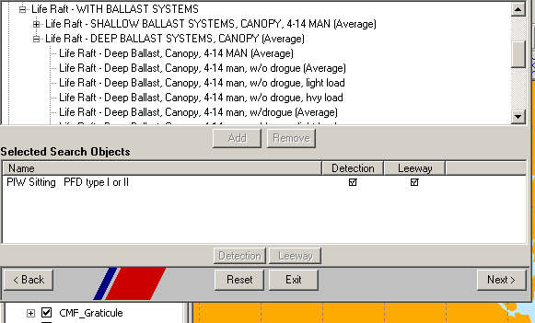
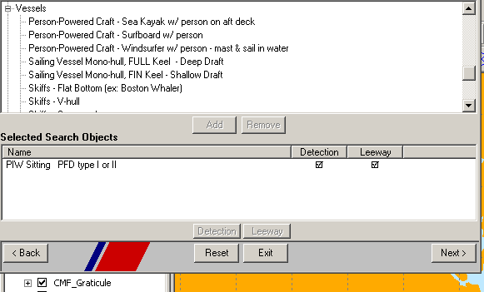
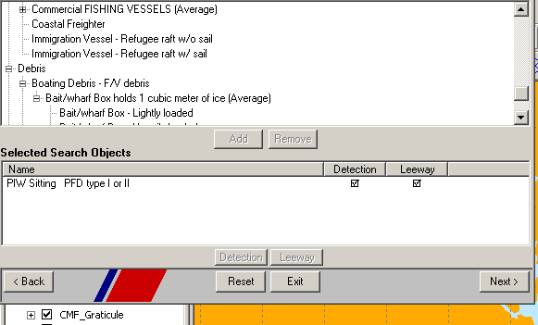
Notes:
Search Object selection page: Leeway and Detection are now combined. Major groups of objects. Survival characteristics to come in a later build.
Added a life raft
Chosen an LKP with 10 nm uncertainty and DTG with no uncertainty in it.
Used the calendar function to input time
Used the mouse to select a LKP position from the map

Slide 12
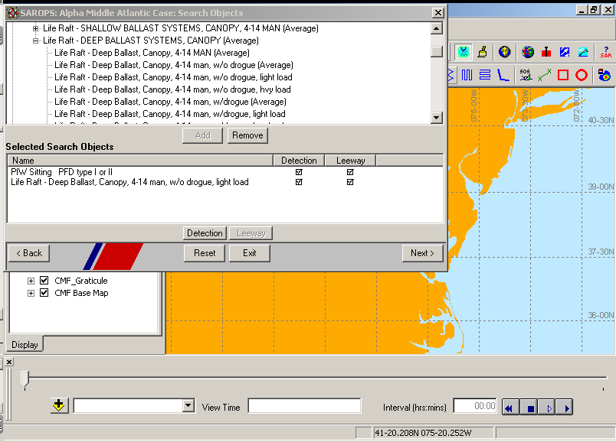
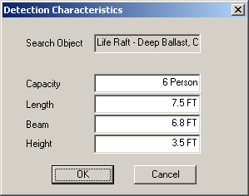
1
3
2
4
5
Notes:
Entered a (1) life raft and its (2&3) capacity got back estimates of length, beam and height of raft. This allows us to use the Detection tables.

Slide 13
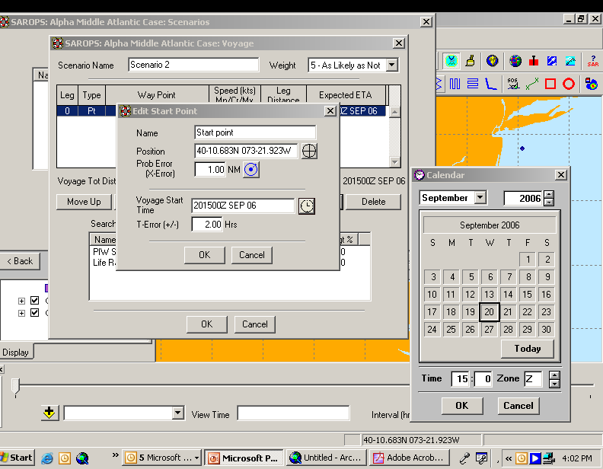
Notes:
Scenarios set up page: LKP, LKP + DR, Area, Voyage
Adding starting point, could have been a starting area. Used mouse to select point off NYC, and the clicked on clock to bring up calendar / time / time zone selector to add center time of point. Added 1 nm 50% radius for point and 2 hours either side of point time for temporal uncertainty.

Slide 14
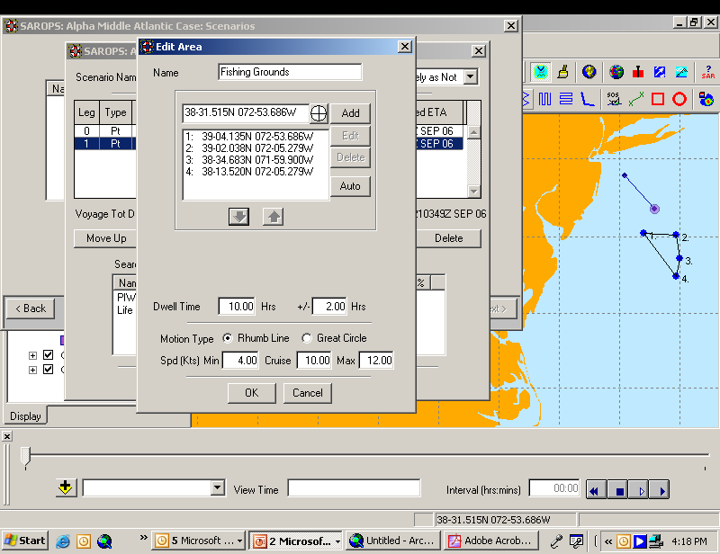
Notes:
Here we have added an area where he will dwell for 8 to 12 hours after arriving. This is models the pre-distress actions of the originating craft.

Slide 15
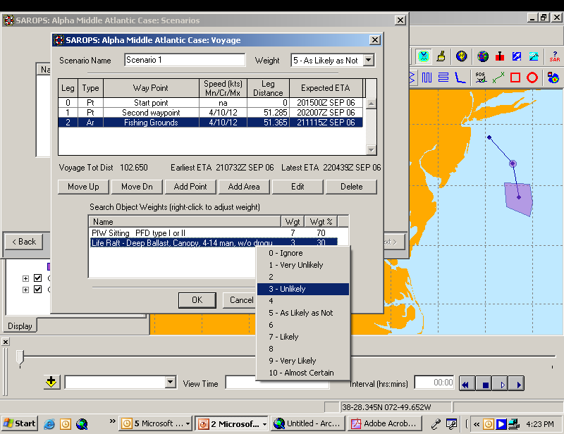
Notes:
First scenario, travel out to area from NYC at 4 to 12 knots.
Adjusted weights of two search objects to be 70% PIW and 30% Life Raft

Slide 16
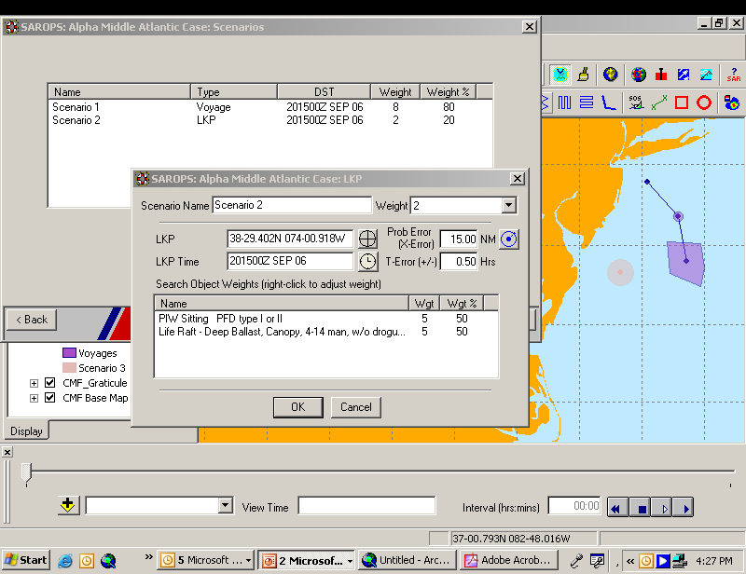
Notes:
Added second scenario of a simple LKP to the southwest of the area.

Slide 17
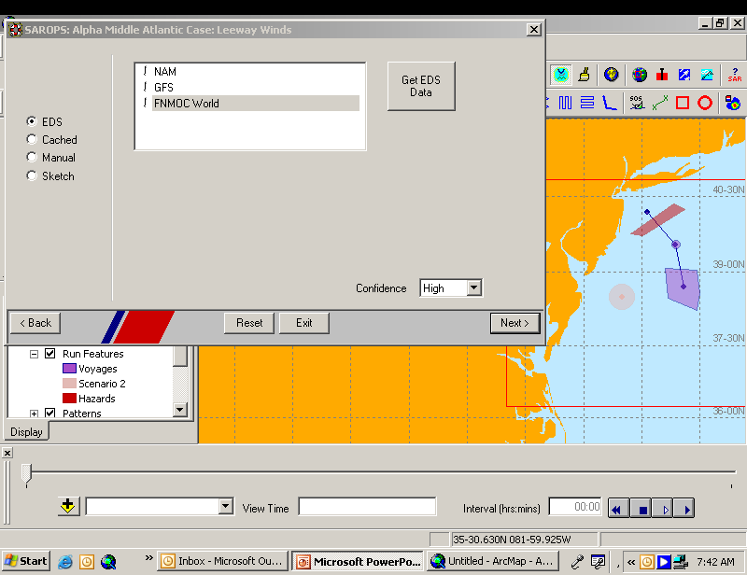
2
3
1
4
Notes:
Chouse Get Data from EDS, stored locally, Manual enter, or OA Sketch Tool
Chouse wind source (NAM, GFS, FNMOC)
Get it
Confidence / Uncertainty Level (for Random Flight Model of Dispersion)

Slide 18
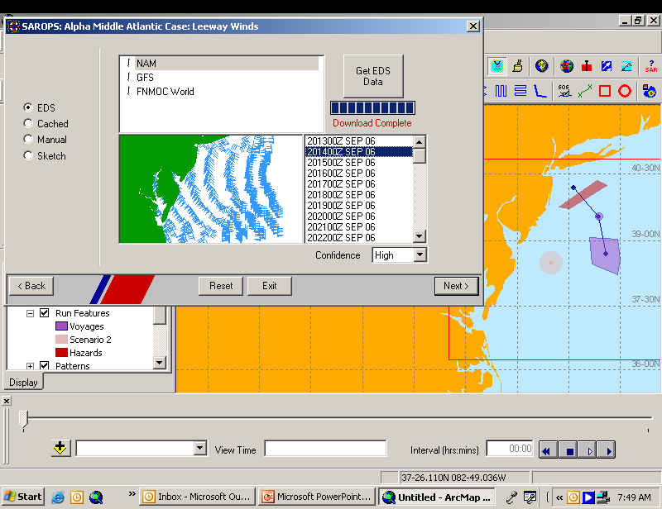
Notes:
Here we have just download the NOAA NCEP’s North America Mesoscale winds for the AOI. We have a button for high or low confidence (low or high uncertainty Gaussian error added to wind vectors).
We apply either a high or low confidence factors to our wind and to current vectors. For wind, the high (low) confidence is a standard deviation of 2.0 (5.0) knots applied to both east and north components of wind , with a tau (half-life of 60 minutes)
For each particle, the draws for the east wind component are correlated, and the correlation depends on the time difference between the draws. If there is no time difference, the draws are exactly the same and we say that the correlation is 1.0. If the draws are for times that are very far apart, there is essentially no correlation, and the draws are essentially unrelated, or independent. In this case, we say that the correlation is 0.0. In between these two extremes, the correlation decays exponentially so that at 60 minutes, the correlation is 0.5.
The exact meaning of the value of the correlation is that it is the value of the correlation coefficient.
The same ideas apply for the north wind component, as well as each of the two current components.
For currents, the high (low) confidence is a standard deviation of 0.25 (0.50) knots applied to both east and north components of current, with half life confidence of 480 minutes (7.8hours), also applied with exponential decay.
{0.1 knot = 5.1 cm/s 0.25 knots = 12.9 cm/s 2.0 knots = 1.0 m/s and 5.0 knots = 2.6 m/s}

Slide 19
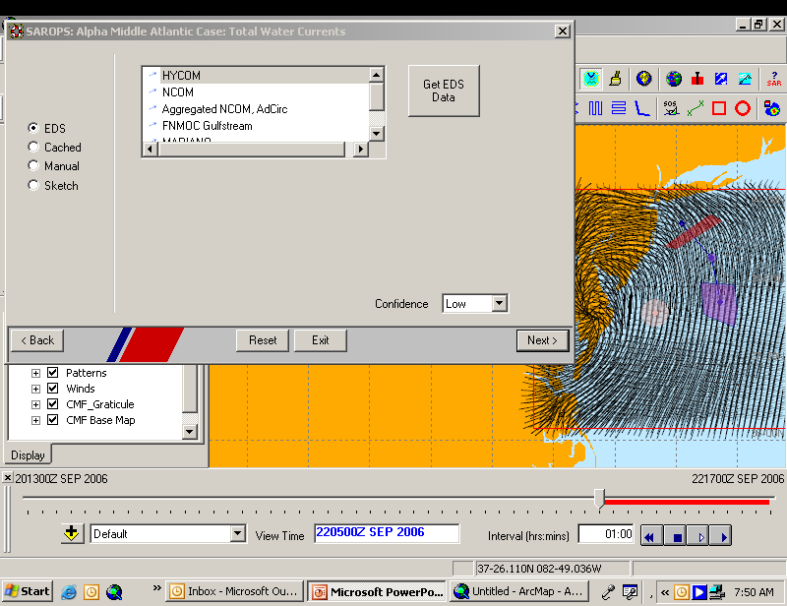
Notes:
Get NOAA North Atlantic HYCOM model surface currents
NAM winds are now shown.
Time Slider is now active
Took about a minute to download HYCOM data for this run

Slide 20
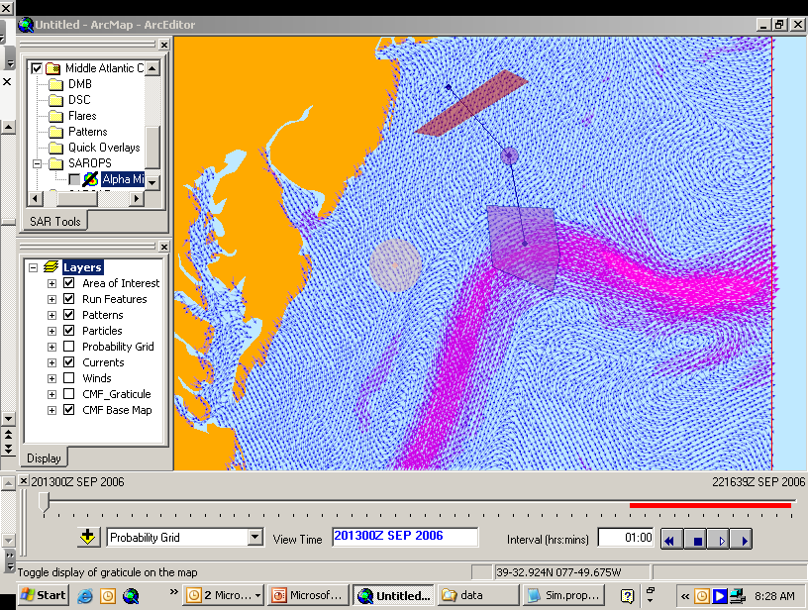
Notes:
Zoom to AOI
I have docked Toolbars on my second screen, to give more room to the AOI
Time zero 20 1300z Sept 2006

Slide 21
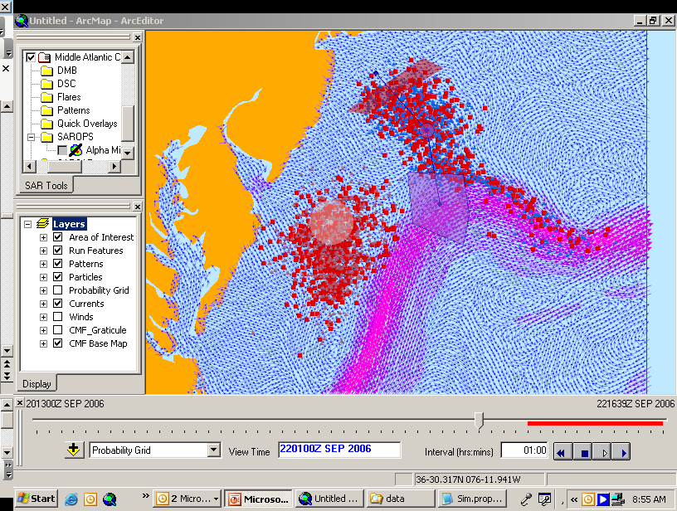
Notes:
36 hours

Slide 22
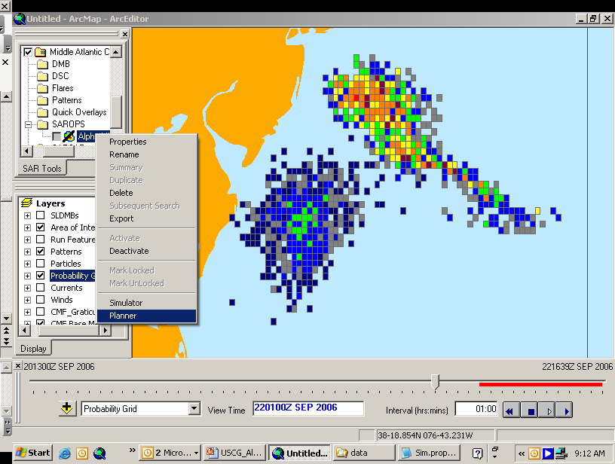
Notes:
Both PIW and Life raft,
Start Planner for search starting at 36 hours

Slide 23
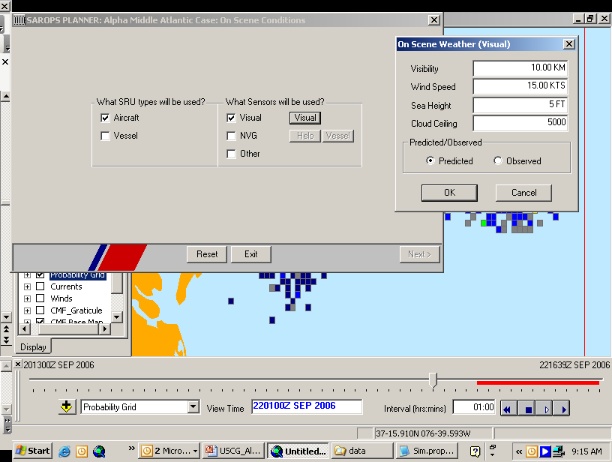
Notes:
Visual search from an Aircraft,

Slide 24
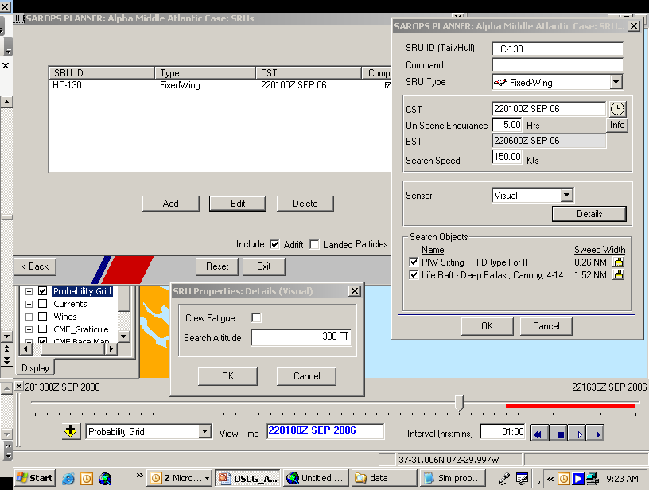
1
5
2
3
4

Slide 25
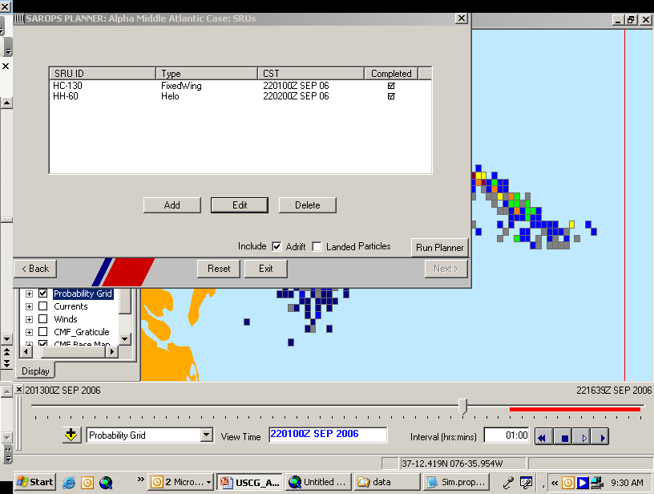

Slide 26
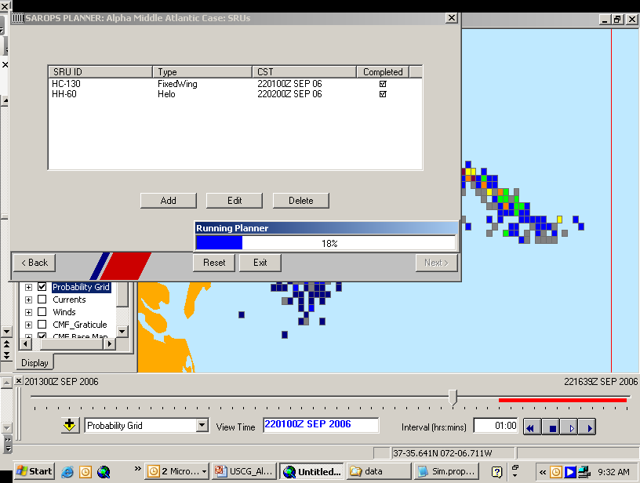
Notes:
The computer takes 90 seconds to return a optimized search, in this case for 2 SRU looking for both objects, starting at their CST.

Slide 27
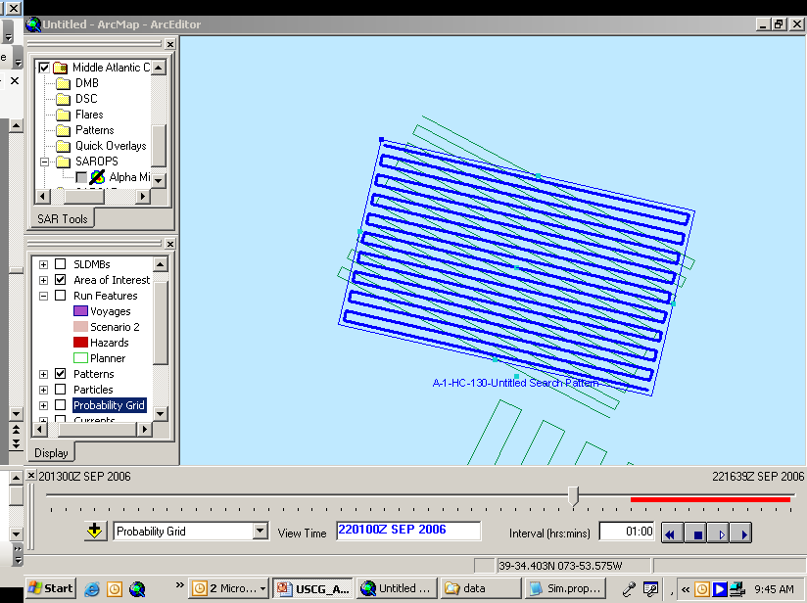
Notes:
Option to change search patterns, on screen or by this input table.

Slide 28
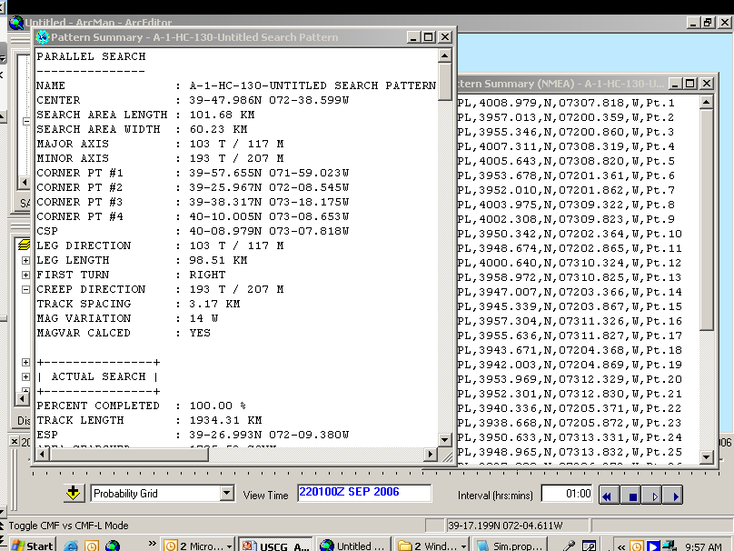
Notes:
Summary of each search pattern in either human readable format or NEMA format for input into a GPS.

Slide 29
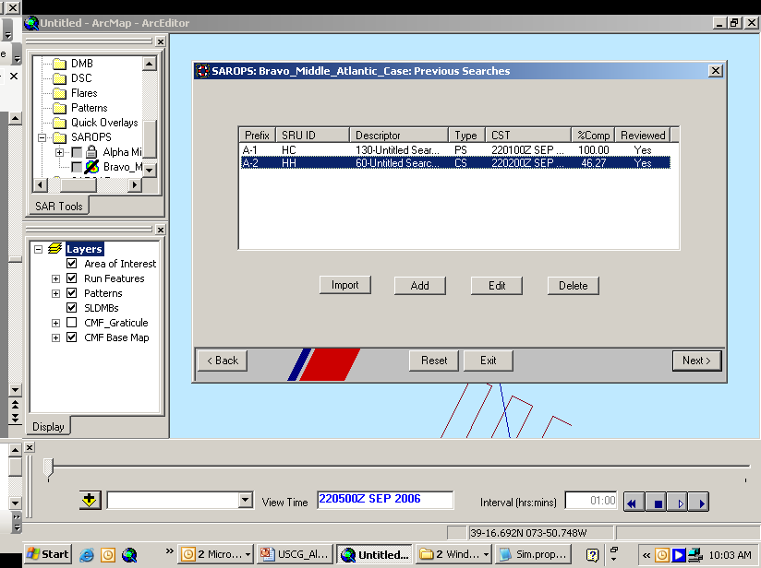
Notes:
Subsequential Searches

Slide 30
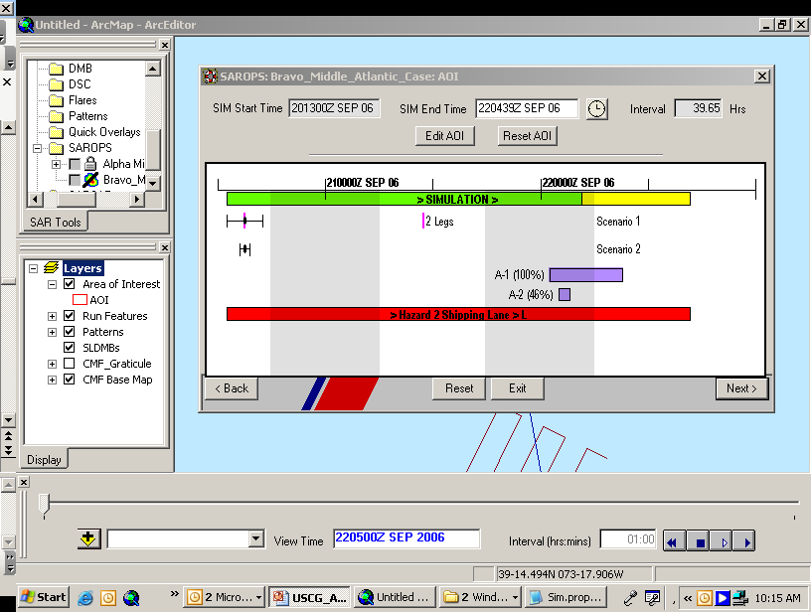
Notes:
Continue thru Simulator, and now the Previous searches are shown on the time lines.

